Slide 1

Welcome & Module Induction
What we learned previously: In Module 3, we transformed how our code looks. We used Linters and Auto-Formatters (like Black) to ensure our scripts meet the industrial PEP 8 standard and look like they were written by a senior engineer.
What we are learning today: We are going to change how we interact with our code. We will stop "hardcoding" variables inside our scripts and instead build a professional Command-Line Interface (CLI) using Python’s built-in argparse library.
Why this will be helpful: In research and production, you will often need to run scripts on massive datasets (like a folder of thermal images or medical scans). A server or an automated pipeline cannot open your .py file to manually change input_folder = "dataset_A" to input_folder = "dataset_B". By building a CLI, you allow machines and other developers to pass instructions directly from the terminal, enabling true automation.

Slide 2
The Hardcoding Trap
The Amateur Way: Opening the script, finding line 12, changing learning_rate = 0.01 to 0.05, saving the file, and hitting run. If you want to run 10 experiments, you have to edit the code 10 times. This is dangerous and impossible to automate.
The Professional Way: Writing the logic once, and passing the variables from the outside: python train_model.py --lr 0.05 --epochs 100.

Slide 3
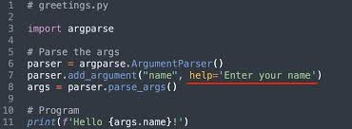
Enter argparse
What it does: It intercepts the words you type in the terminal after the script name and safely converts them into Python variables your code can use.
The Magic Help Menu: The best feature of argparse is that if you type python script.py --help, it automatically reads your code and generates a professional, formatted instruction manual for your tool. You get world-class documentation with zero extra effort.

